Slide 1

Webinar on Transparency Without Borders: Global Experiences in Access to Information
ATI Empowerment for Groups in Situations of Vulnerability
6 October 2025
Toby Mendel
Executive Director

Slide 2
Overview
Some general points about RTI
Specific areas where RTI is important for the vulnerable
Some concrete examples of use of RTI to benefit the vulnerable
Features that are needed for the vulnerable to be able to use RTI laws

Slide 3
General Points about RTI
  Both enable requests and set a minimum bar for proactive disclosure: both important for the vulnerable
  Laws: 14 to 141 and counting (Senegal in Sept. 2025)
  Recognition as a human right
  Includes access to records (documents), information and data (structured information, like data sheets)

Slide 5
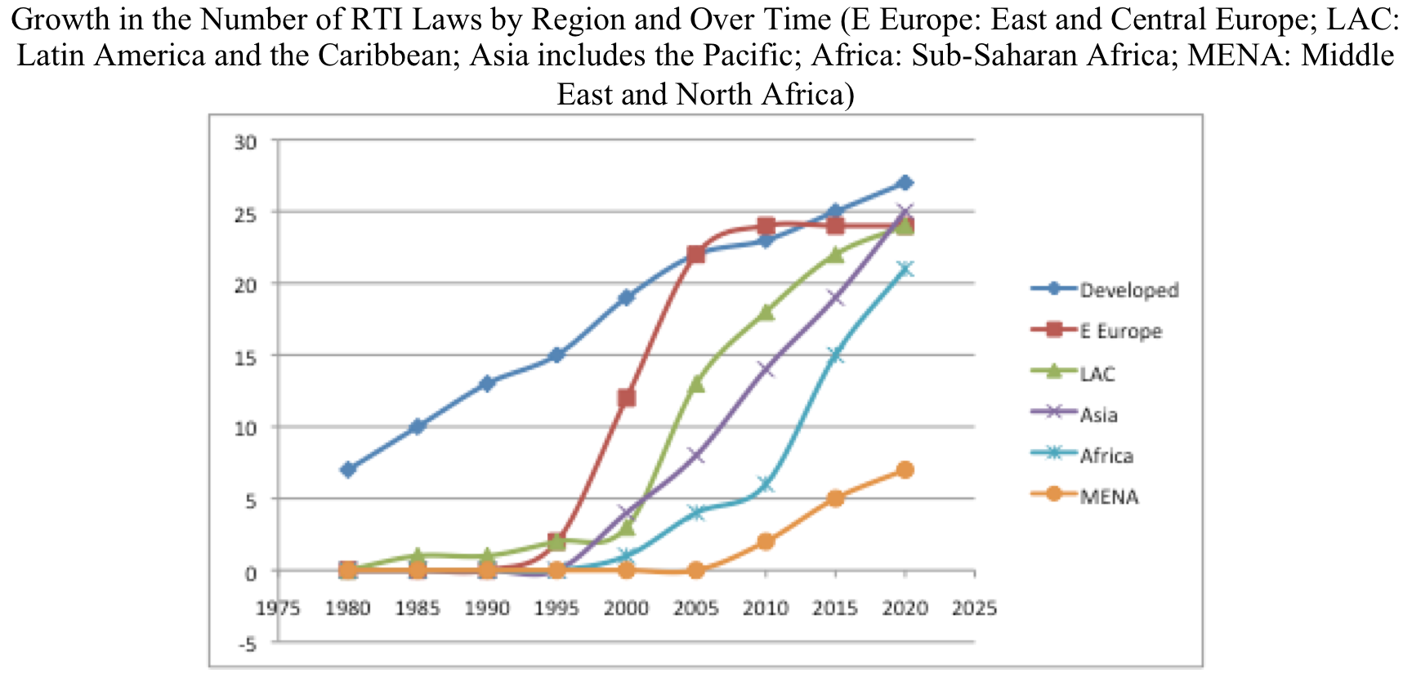

Slide 6
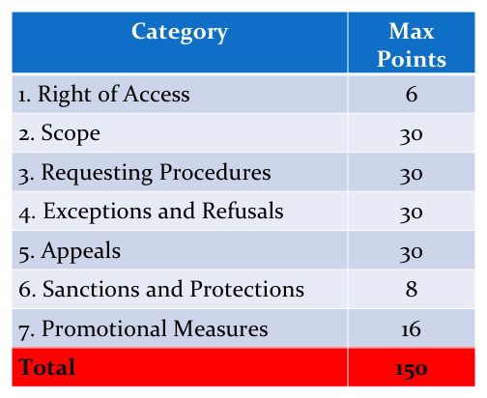
RTI Rating

Slide 7
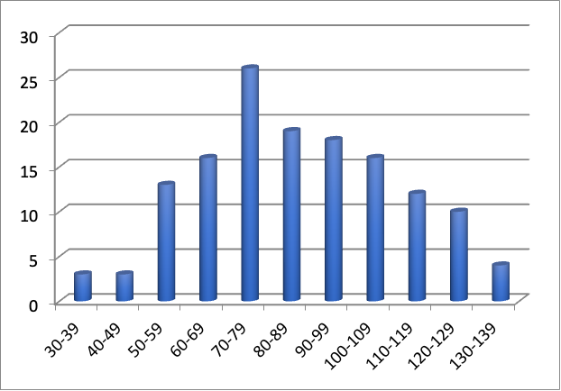
Score of Laws per 10-point Range

Slide 8
Why Important for Vulnerable Groups
RTI laws have been shown to lead to many benefits, which we will canvas in the following slides
Some general points about RTI and the vulnerable:
  Studies show that responses to requests for information often discriminate against women and other vulnerable groups
  At the same time, the vulnerable have often used RTI to obtain specific benefits
  This generally helps reduce discrimination and supports equality

Slide 9
Benefits of RTI: Participation
Widely recognized as a key rationale for RTI
Even if there are formal opportunities to participate, genuine (effective) participation depends on information
Should apply at all levels
  For the vulnerable, local level is often the most important
Example from Salima District of Malawi
  Poor garbage collection was leading to problems, including disease
  Citizens used RTI to find that the contract was not being followed; then approached the local council
  Eventually, the council addressed the problem

Slide 10
Benefits of RTI: Accountability
Another historic rationale for RTI: cannot hold public actors to account if we don’t know what they are doing
Again, often the local level most important for vulnerable groups
Example from Thati Baal Village in India
  Local population were frustrated that a local teacher was not attending school or distributing scholarship money to students
  Request for information about attendance led the responsible government officer to attend the 46 student school
  Found the teacher absent and students not receiving scholarships so took action to address it

Slide 11
Benefits of RTI: Accountability, cont’d
Example from Chiapas, Mexico
  A local clinic lacked a doctor and medical supplies
  Request for information revealed what the clinic was supposed to be receiving
  The local community was mobilised and the doctor and supplies were eventually allocated

Slide 12
Benefits of RTI: Corruption
Yet a third very important rationale for RTI
Stories often focus on high-profile corruption but local corruption is often what hurts vulnerable groups the most
Example from Rajasthan, India
  Local officials were stealing funds being allocated to development projects and to feed the poor
  RTI requests revealed that local people had signed for wages for the work or for the food
  Activists held local meetings: the payment rolls were read out and the “beneficiaries” indicated they had received nothing
  This led to punishment of the officials and had a broad impact in ending the practice

Slide 13
Benefits of RTI: Health and Safety
RTI can either lead to accountability for health and safety risks, preventing further harm, or to prevention
Example from Sri Lanka’s Meethotamulla District:
  A 90m crest in a 22-acre trash mountain collapsed killing several poor people working there
  Using RTI, a media outlet managed to find out and expose irregularities
  The authorities reacted by addressing the irregularities

Slide 14
Benefits of RTI: Environment
Environmental activists were among the most active early RTI campaigners
RTI has been used, among other things, to expose what has come to be called environmental racism
Example from Nova Scotia, Canada:
  The government approved a plan for natural gas storage in salt deposits near a river flowing through an indigenous area
  An RTI request showed that company records indicated this would result in salinity levels 6 times greater than was safe for fish
  The approval was cancelled after local campaigning based on that information

Slide 15
Key RTI Features for Vulnerable Use
  Access needs to be inclusive
  Citizens versions of records
  Proactive disclosure which is geographically and technologically accessible
  Disclosure in local languages
  Accessible systems for requesting
  Assistance
  Online systems available on mobile phones
  Social barriers, e.g. female information officers and commissioners
Awareness
  Need culturally appropriate outreach
  Community-based approach (e.g. adapting messages for women or different groups)

Slide 16
Thank you
Toby Mendel, Executive Director, Centre for Law
and Democracy
toby@law-democracy.org
www.law-democracy.org

