Slide 1
Sharing Information in Situations Involving Intimate Partner Violence: Guidance for Professionals Karishma Firdausi, Policy Analyst Office of the Information and Privacy Commissioner of Ontario
International Conference of Information Commissioners – GSV Working Group
October 6, 2025

Slide 2
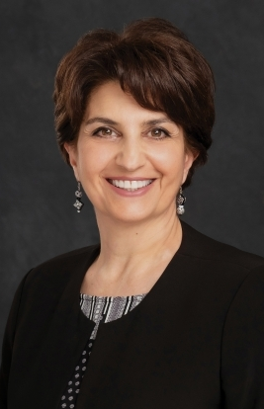
INFORMATION AND PRIVACY COMMISSIONER OF ONTARIO
Patricia Kosseim, Ontario’s Information and Privacy Commissioner (IPC), is an officer of the Legislature who is:
appointed by, and reports to the Legislative Assembly of Ontario
independent of the government of the day
The IPC oversees compliance with:
the Freedom of Information and Protection of Privacy Act (FIPPA)
the Municipal Freedom of Information and Protection of Privacy Act (MFIPPA)
the Personal Health Information Protection Act (PHIPA)
Part X of the Child, Youth and Family Services Act (CYFSA)
the Anti-Racism Act (ARA)

Slide 3
2022 CORONER’S INQUEST AND JURY RECOMMENDATION 78 What led the IPC to develop guidance around information sharing for IPV prevention?
In 2022, the Office of the Chief Coroner of Ontario released its verdict into the deaths of three women due to intimate partner violence (IPV) in Renfrew County, Ontario (known as the CKW Inquest).
Jury recommendation 78 called on the IPC to develop guidance to empower professionals to make informed decisions about privacy, confidentiality, and public safety
Resulting from the CKW Inquest, several Ontario municipalities began declaring IPV an epidemic.
We held early consultations with subject matter experts from the CKW Inquest to better understand jury recommendation 78 and learned about the importance of taking a trauma- and violence informed approach to policy development.

Slide 4
CONSULTATIONS AND GUIDE DEVELOPMENT PROCESS Who did the IPC consult when developing this guidance?
Sector / Individuals | Organizations
Justice | Barrie Police Service Domestic Violence Death Review Committee Ontario Association of Chiefs of Police Office for Victims of Crime Ontario Victims Services Toronto Police Service
Health care | Alliance for Healthier Communities College of Psychologists of Ontario Ontario College of Social Workers and Social Service Workers
Child welfare | Association of Native Child and Family Services Agencies of Ontario Ministry of Children, Community and Social Services Ontario Association of Children’s Aid Societies
IPV service providers | Bernadette McCann House Building a Bigger Wave Catholic Family Services Peel-Dufferin Inquest Counsel to EVA-Renfrew County Lanark County Interval House and Community Support Luke’s Place Ontario Association of Interval and Transition Houses Victim Services of Renfrew County WomanACT
Survivors of IPV | A diverse group of women that identify as survivors of IPV. The group included Indigenous and racialized women who talked about their experiences navigating Ontario’s access and privacy laws and the structural barriers they face.

Slide 5
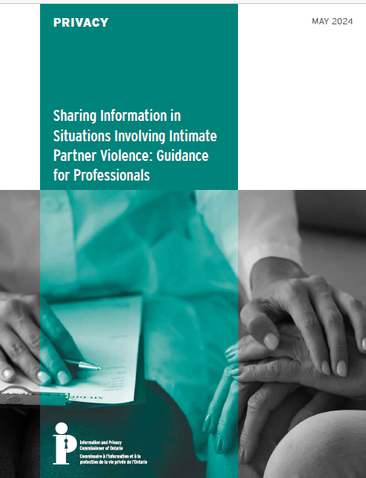
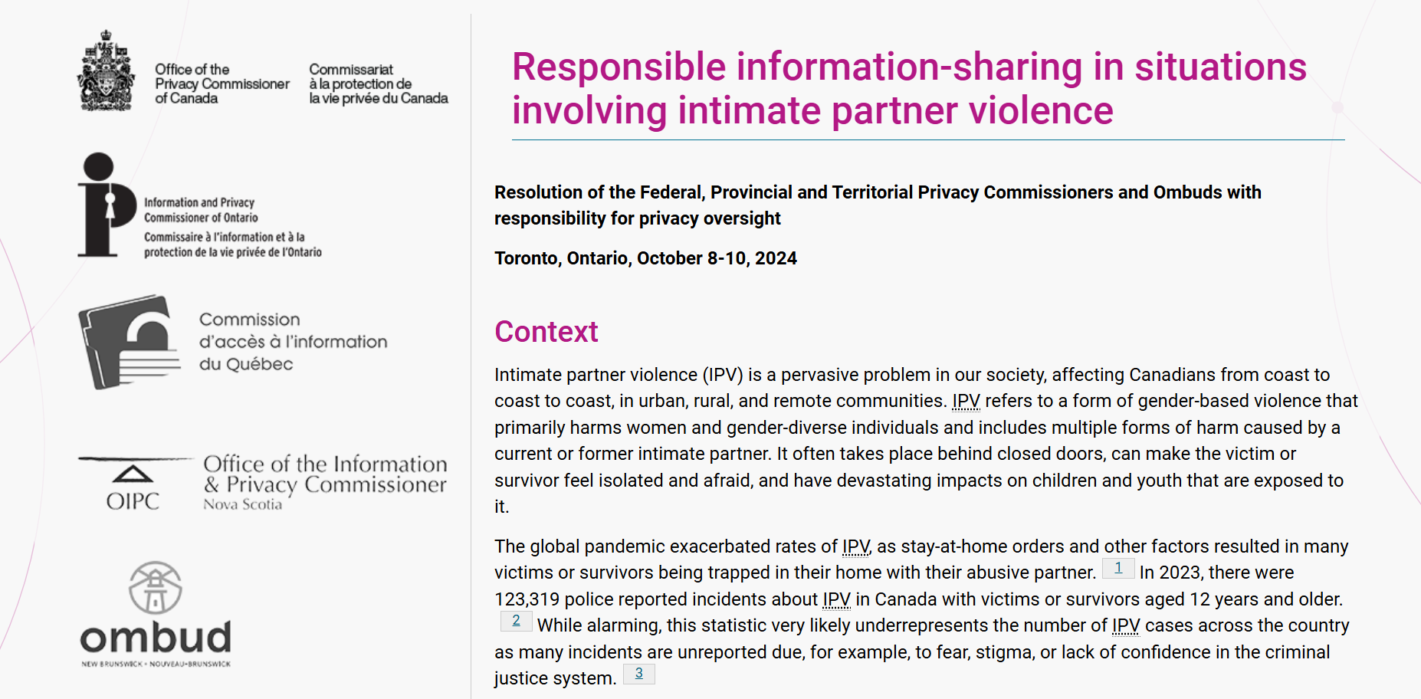
IPC GUIDANCE AND JOINT FPT RESOLUTION
What was the result of the IPC's consultation efforts?
May 2024
October 2024
Sharing Information in Situations Involving Intimate Partner Violence: Guidance for Professionals | Information and Privacy Commissioner of Ontario
Responsible information-sharing in situations involving intimate partner violence

Slide 6
LESSONS LEARNED What were some lessons learned from the Regulators perspective?
1
Modern and Effective Consultative Approach
3
4
Culturally Sensitive and Trauma-informed Approach to Policy Making
Collaboration with Regulators across Canada
Unified voice and commitment to safeguard the rights of at-risk groups
Building trust and relationships with external partners for real world impact
2
Transparency and Accountability
Engaging with survivors to learn from their unique experiences
Being open, transparent, and accountable to external partners

Slide 7
QUESTIONS?

Slide 8
EMAIL CONTACT INFORMATION
Karishma.Firdausi@ipc.on.ca

