Slide 1

ACCESS TO INFORMATION FOR GROUPS IN SITUATION OF VULNERABILITY
OCTOBER 6, 2025

Slide 2
PRESENTATION OUTLINE
Introduction
Protection of Groups in Situations of Vulnerability in Malawi
Current gaps in access to information for GSV in Malawi
What need to be done

Slide 3
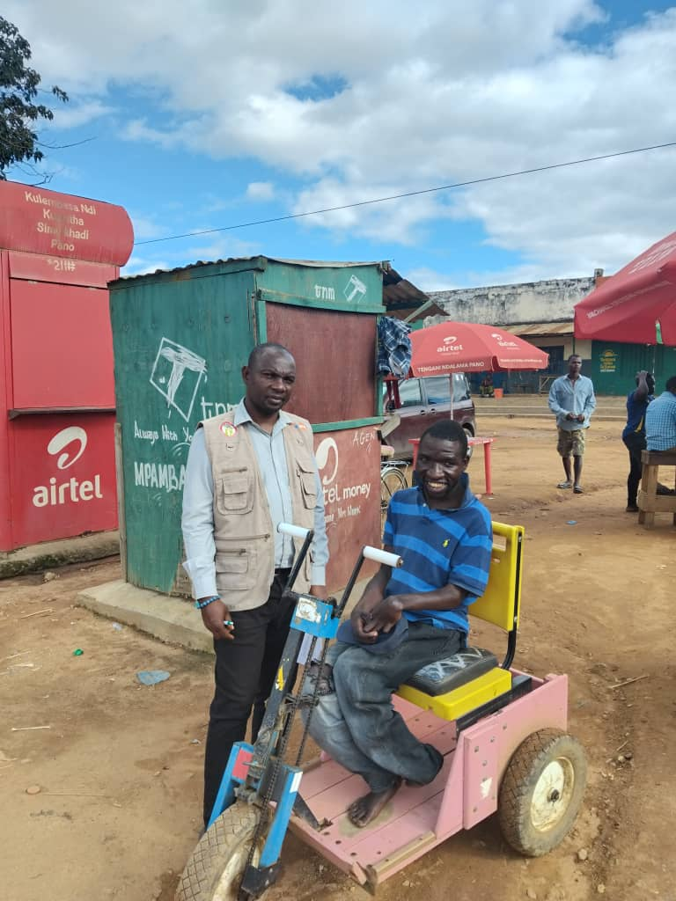
ACCESS TO ELECTORAL CIVIC EDUCATION FOR VULNERABLE GROUPS 2025

Slide 4
INTRODUCTION
Groups in a situation of vulnerability in Malawi:
Persons with disabilities. 11.6% of a population of 20 million or more. The majority are those with hearing impairment and mobility challenges
25.5% of the population that cannot read or write
The elderly
Different local languages-more than 20 spoken languages
Refugees and asylum seekers
Women and children

Slide 5
PROTECTION OF GROUPS IN SITUATION OF VULNERABILITY IN MALAWI
Section 20 of the Constitution of the Republic of Malawi prohibits any forms of discrimination
Malawi has enacted legislations that protect different groups of people, directly addressing their need for access to information e.g. Older Persons, Persons with Disabilities, Child Care, Justice and Protection, persons with albinism etc
Access to Information law obligates information holders to provide information in the formats requested by the information seeker e.g. audio, braille, large prints

Slide 6
CONT’
Visually impaired persons are exempt from paying any fee for the reproduction of braille materials
Access to information is free

Slide 7
NOTABLE PROGRESS
Use of braille materials during the elections for persons with visual impairment
Sign language interpreters on the state broadcaster as well as in public functions
2025 General Elections Results were announced in the national local language

Slide 8
CURRENT GAPS
Information is mostly disseminated in ordinary formats
Access to assistive devices by persons with visual impairment is quite limited
Venues where meetings are conducted are not conducive for persons with disabilities to attend.

Slide 9
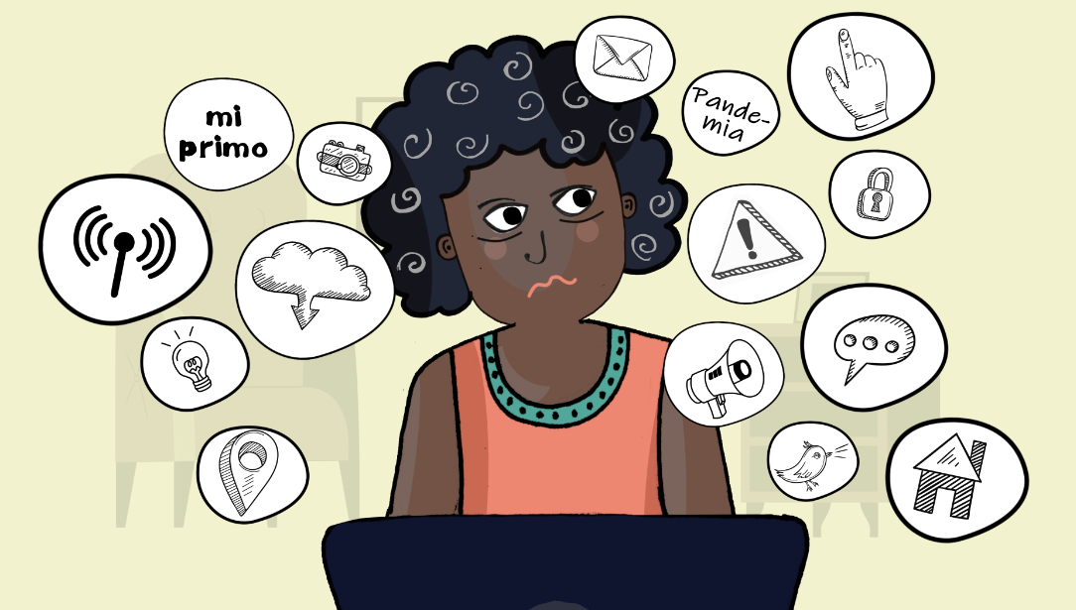
What must we do then?
Everyone has a role to play, especially the Government, as a primary duty bearer, has a greater responsibility

Slide 10
CONT’
increase awareness about the rights of groups in vulnerable situations
Advocate for the respect and protection of the rights of vulnerable groups
Strengthen the existing laws that protect the rights of groups in vulnerable situations

Slide 11
Thank You

